Slide 1
Chapter 1
Introduction to OOP

Slide 2
Objective
Understand what is Object Oriented programming?
Understand the principles of OOP
How is OOP different from Procedural languages
Problems in Procedural programming and how OOP overcomes them
Applications of OOP
Understand UML notations

Slide 3
Procedural Languages
C, PASCAL, FORTRAN languages are all procedural languages.
A program is a list of instructions.
Complexity increases as the length of a program increases .
Divide a large program into different functions or modules
Problems with Procedural languages
functions have unrestricted access to global data
that they provide poor mapping to real world.
Procedural languages are not extensible.

Slide 4
Introduction to OOP
A programming paradigm
deals with concepts of object to build programs and software applications
Modeled around real world
The world we live in is full of objects.
Every object has a well defined identity, attributes and behavior.
Objects exhibit the same behavior in programming.

Slide 5
OOP Principles
Classes
Objects
Abstraction
Encapsulation
Inheritance
Polymorphism

Slide 6
Class
blueprint for an object, a plan, or template
Description of a number of similar objects is also called class.
A class is also defined as a new data type; a user defined type.
Defining a class doesn’t create an object.
Classes are logical in nature.
For e.g. Furniture do not have any existence but tables and chairs do exist.

Slide 7
Object
Defined as instance of a class. for e.g. table, chair are all instances of the class Furniture.
Objects have unique identity, state and behavior
State is defined by the attributes of the object.
Different objects have different attributes ( characteristics)
For e.g. the attributes of student are name, roll number etc
Behavior actually determines the way an object interacts with other objects.
Synonym to functions

Slide 8
Abstraction
In real life, Humans manage complexity by abstracting details away.
In programming, we manage complexity by concentrating only on the essential characteristics and suppressing implementation details.
For e.g. Car.

Slide 9
Inheritance
Way to adopt characteristics of a class into another class.
have two types of classes one is base class and other is subclass.
A parent-child relationship among classes in inheritance.
A subclass inherits all the properties of base class. In addition to this it can add its own features (properties and behavior).
For e.g. we can categorize vehicle into car, bus, scooter, ships, planes etc.

Slide 10
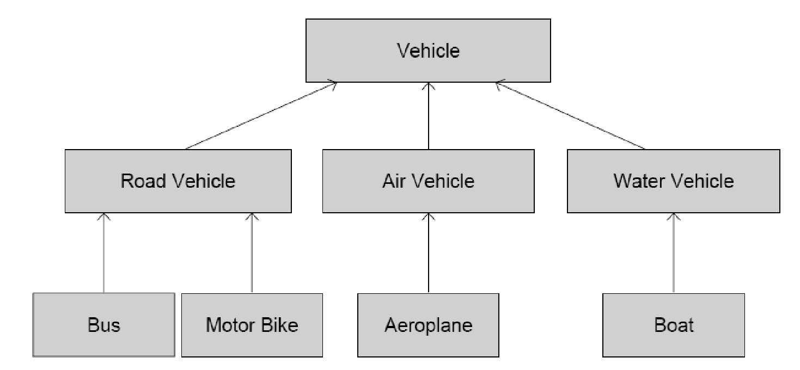
Inheritance

Slide 11
Encapsulation
Binding of data and procedure
Restrict any one to directly alter our data.
Also known as Data hiding.

Slide 12
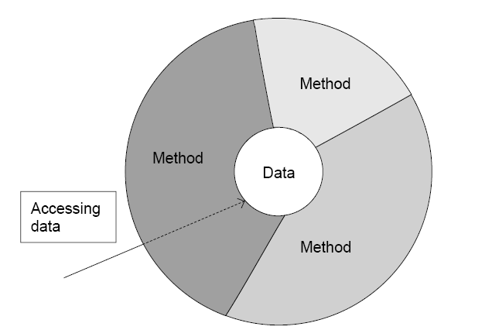
Encapsulation

Slide 13
Polymorphism
Polymorphism means many forms.
Same thing being used in different forms. For e.g. certain bacteria that exhibit more than one morphological form.
Operating overloading is not supported by java
addition operator (+) is an exception can be used for addition of two integers as well as concatenation of two strings.
Compile-time and Run-time polymorphism

Slide 14
Your Turn
What is a class?
What is an object?
What are the various Object Oriented Principles?

Slide 15
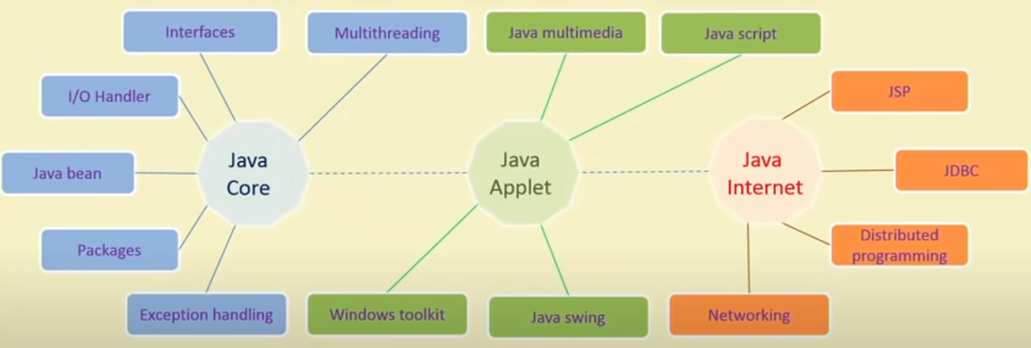
Features of Java Programming

Slide 16
Comparison of OO and Procedural Languages
Procedural language | Object Oriented language
Separate data from function that operate on them | Encapsulate data and methods in a class
Not suitable for defining abstract types | Suitable for defining abstract types
Debugging is difficult | Debugging is easier
Difficult to implement change | Easier to manage and implement change
Not suitable for larger applications/ programs | Suitable for larger programs and applications
Do not have any access specifier | Has three access specifier
Analysis and design not so easy | Analysis and Design Made Easier
Faster | Slower
Less flexible | Highly flexible
Data and procedure based | Object oriented
Less reusable | More reusable
Only data and procedures are there | Inheritance, encapsulation and polymorphism are key features
Use top down approach | Use bottom up approach
Only a function call to another | Object communication is there
C, Basic, FORTRAN | JAVA,C++, VB.NET, C#.NET

Slide 17
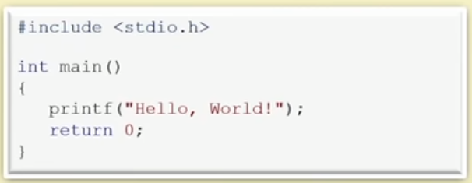
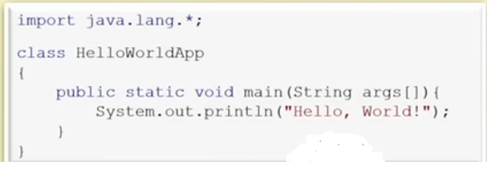
First Program in Java

Slide 18
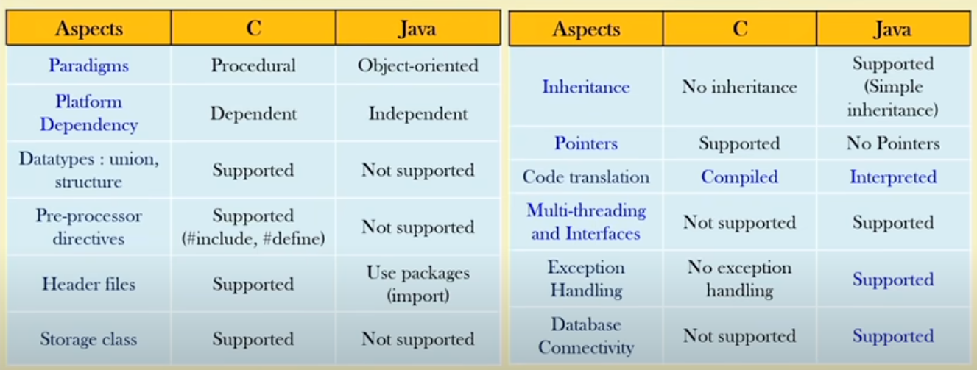
C vs Java

Slide 19
How to execute Java code?
Use any text editor
Write a code and save file with .java extension
Note: Name of file and class name should be same
Java compilation
Open a command shell
Move the directory where Java code has been saved
Run this command: javac name_of_file.java
Java execution
Run this command: java name_of_file

Slide 20
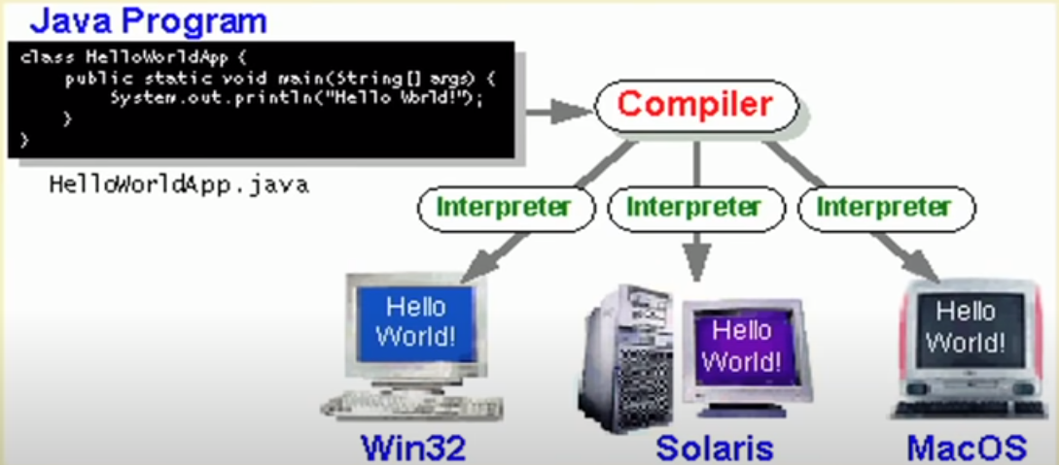
Platform dependent or independent?

Slide 21
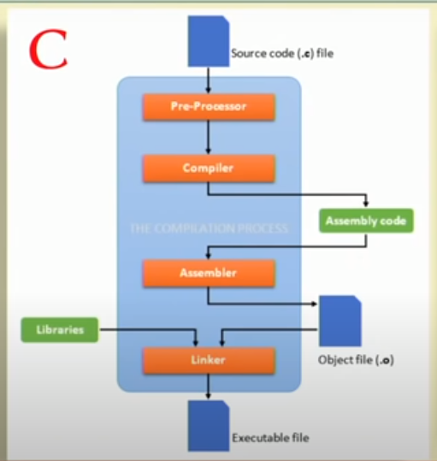
Execution of C

Slide 22
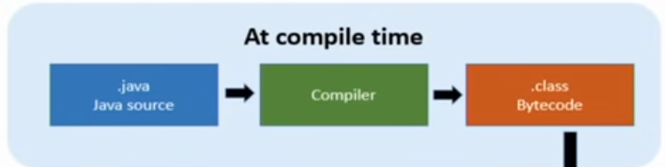
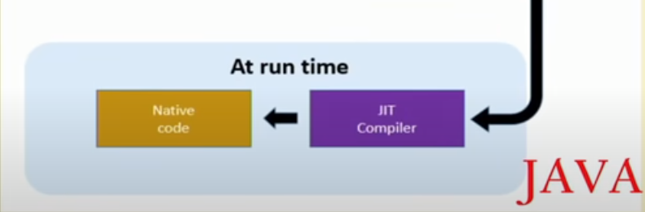
Execution of Java

Slide 23
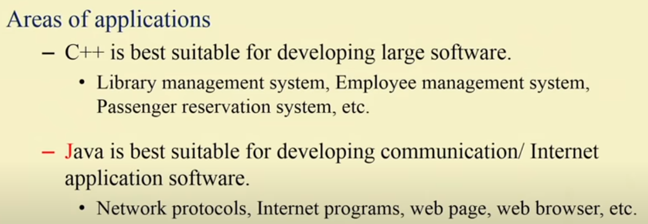

Slide 24
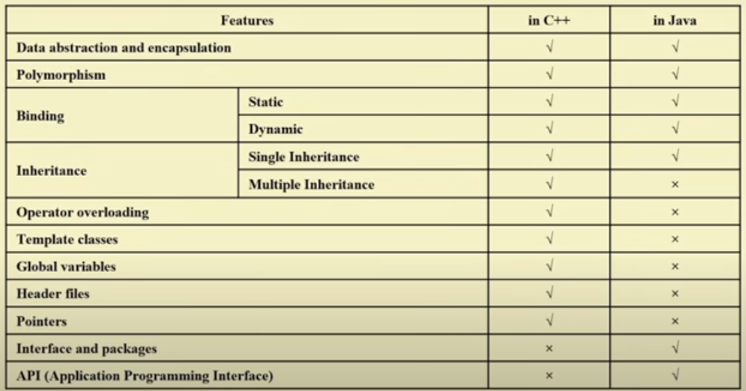
C++ vs Java

Slide 25
Tools available for Java
Java SDK / JDK
Main Programs in Java SDK/JDK
java : interpreter
Javac : complier
Javadoc : generate documentation in html
appletviewer : java interpreter to execute applet
Jdb : Debugger
Javap : Disassembler
Javah : create interface between C and Java

Slide 26
Website
Javapoint.com
Java.com
Java.sun.com/j2se/1.4.2/docs/index.html
Java.sun.com/docs/books/tutorial/index.html
API documentation : Java.sun.com/reference/docs/

Slide 27
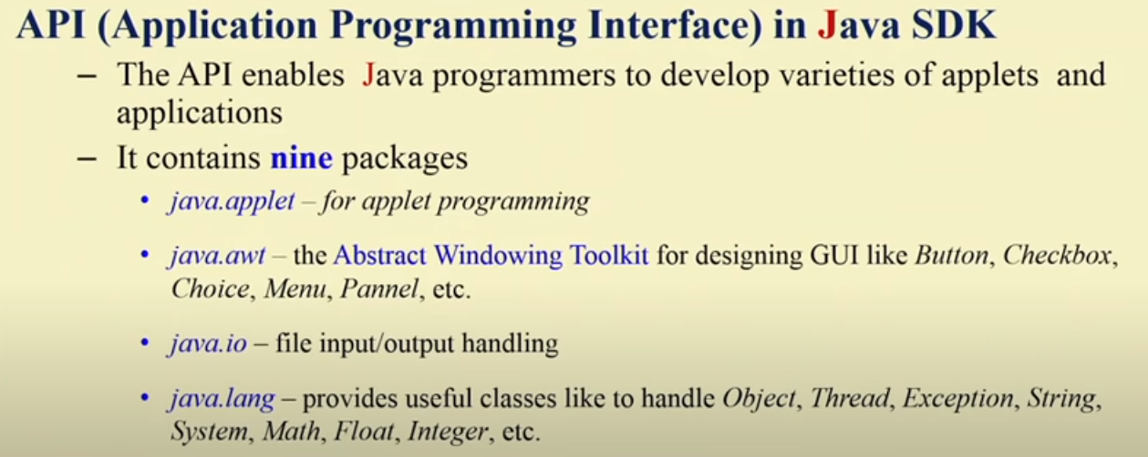
Packages in Java

Slide 28
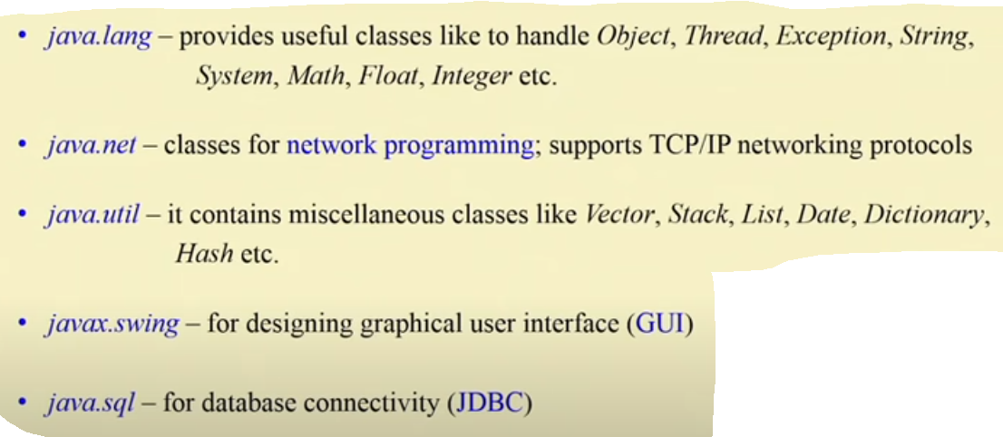
Packages in Java

Slide 29
Java IDE
Sun’s Java workshop
Mojo
Jumba
Semantic café
HotJava

Slide 30
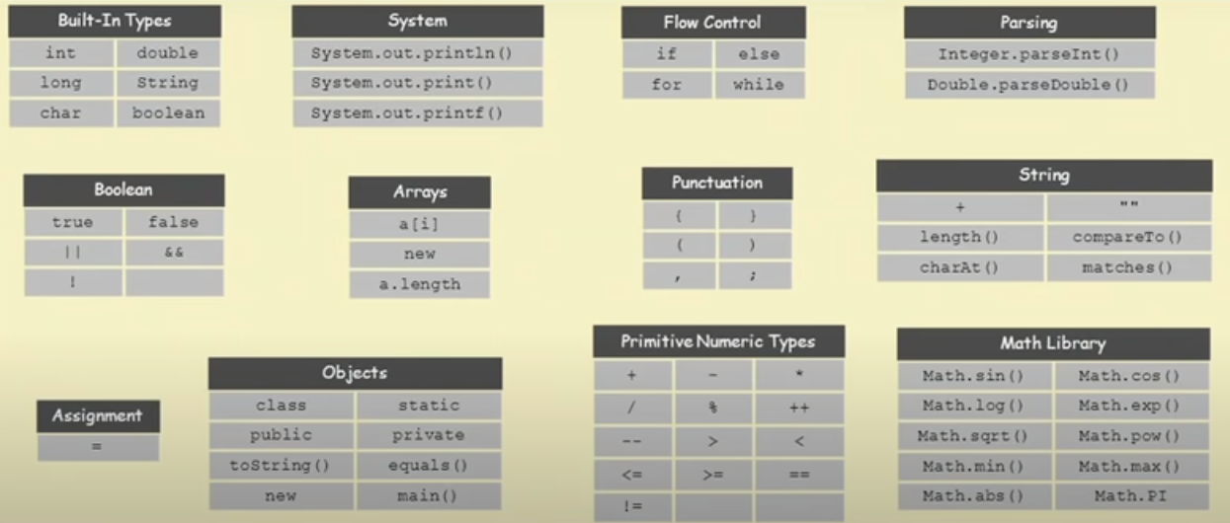

Slide 31
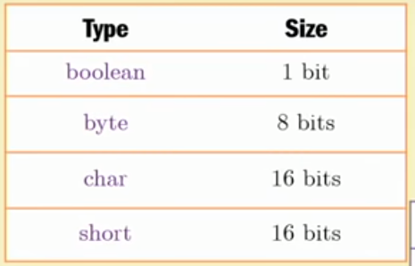
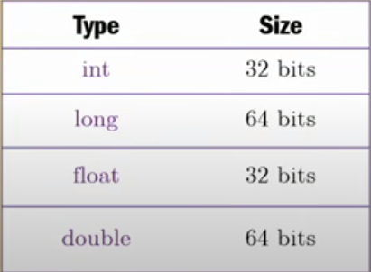
Data type

Slide 32
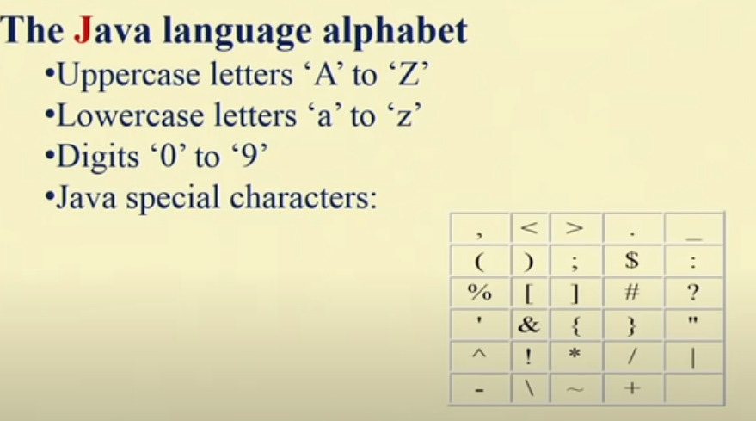
Character set

Slide 33
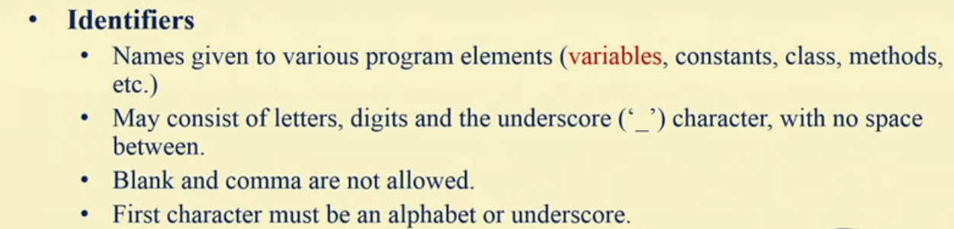

Slide 34
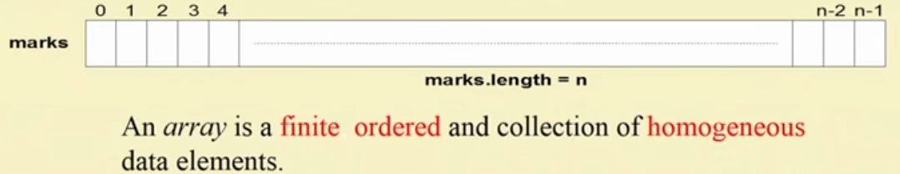
Array in Java
3 Task
Declaration
Allocation
Loading

Slide 35
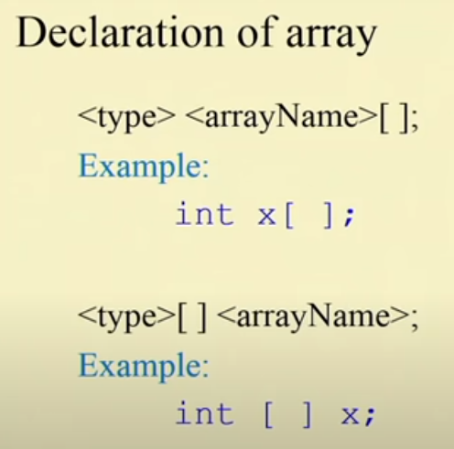

Slide 36
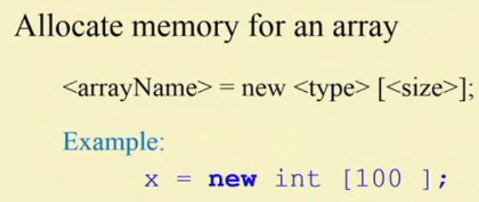
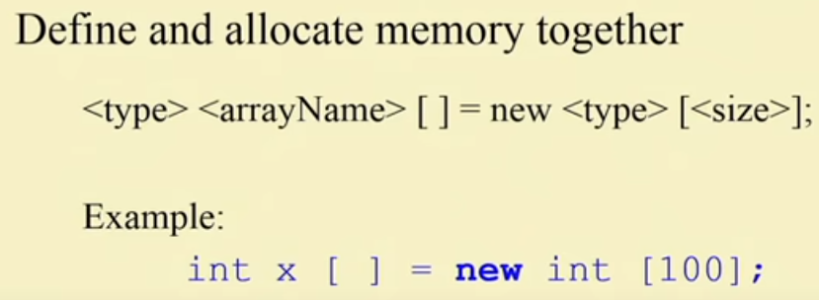

Slide 37
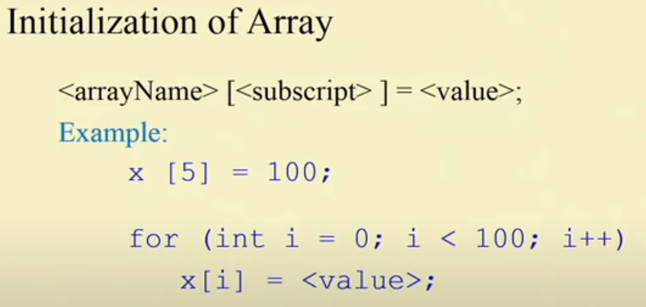
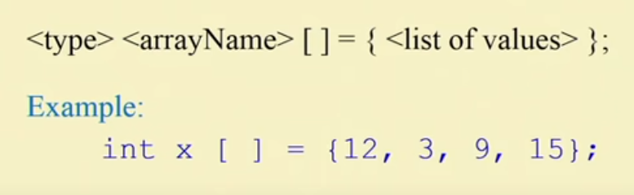

Slide 38
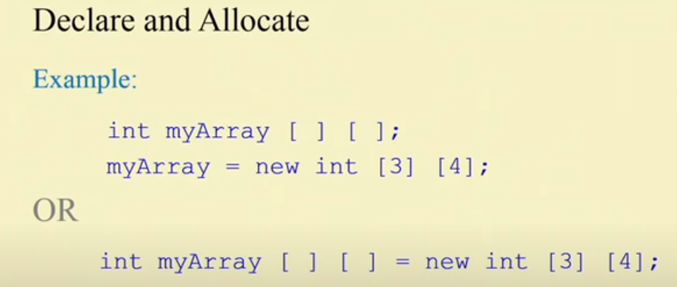
2D array

Slide 39
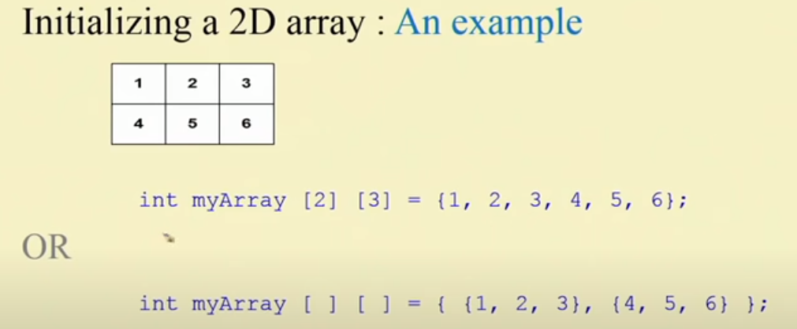

Slide 40
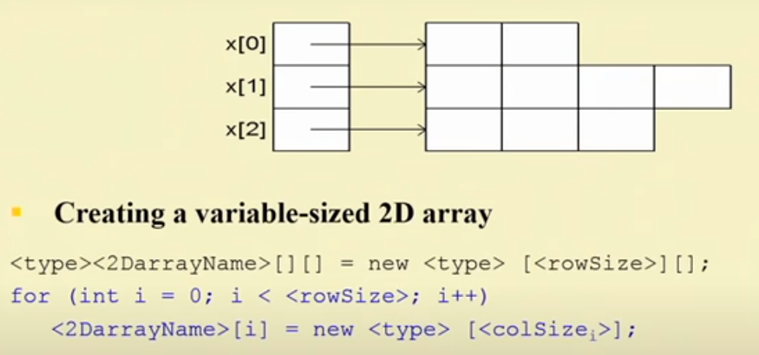
Variable size 2D array

Slide 41
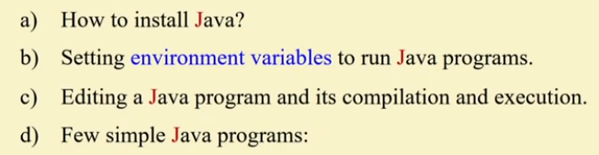
Installation and execution of Java

Slide 42
UML
a standard language for OOAD
graphical notation for all entities (class, object e.t.c)
helps in visualising the system
reducing complexity and improving software quality.

Slide 43
UML Notation For class
Employee
Class
name
address
designation
salary
Attributes
addEmployee
deleteEmployee
searchEmployee
Behavior

Slide 44
UML Notation for Object
:Employee
Object
name=peter
address=NY
designation=manager
salary=10000
Attributes
addEmployee
deleteEmployee
searchEmployee

Slide 45
Multiplicity
An instance of a class can be related to any number of instances of other class known as multiplicity of the relation.
One-to-one
One-to-many
Many-to-many

Slide 46

One-to-One relation

Slide 47

One to Many

Slide 48
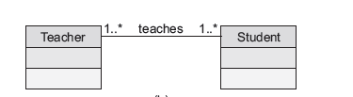
Many-to-many

Slide 49
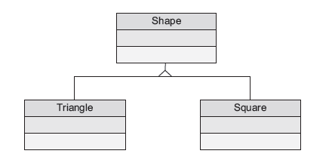
Notation for Inheritance
Triangle and square are two type of shape.
They inherit Shape class.

Slide 50
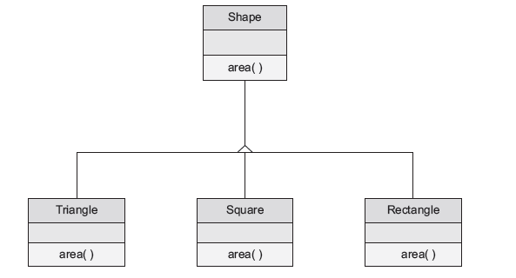
UML Diagram depicting polymorphism

Slide 51
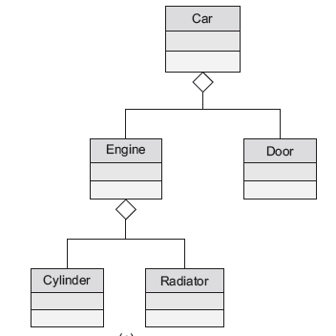
Aggregation

Slide 52
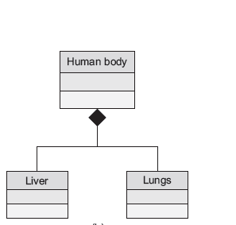
Composition

Slide 53
Application for OOP
Real Time systems
Artificial Intelligence
Expert Systems
Neural Networks
Database Management
Mobile Applications

Slide 54
Summary
OOP revolves around object and classes.
A class is defined as group of objects with similar attributes and behavior.
OOP principles are Inheritance, Abstraction, Encapsulation and Polymorphism.
For building large projects a technique known as OOAD is used.
OOA deals with what the system should do and OOD deals with how the system achieves what has been specified by OO Analysis.
OOAD is realized with the help of a language known as UML.
UML stands for Unified modeling language is a standard language used for visualizing the software.

